Slide 1
Health Psychology and Neuropsychology in Dementia - the foundation of Tai Chi Movement for Wellbeing (TMW)
Dr David Quinn
Consultant Clinical and health Psychologist
Halliday Quinn Limited

Slide 2
“…In 65 years, the NHS has quite simply done more to improve people’s lives than any other institution in our history. But too often the people it fails are its heaviest users – our most vulnerable and elderly. Too often these people end up in hospital not by design, but simply because they can’t get the care they need elsewhere…”
Jeremy Hunt – Health Secretary (DOH Website)

Slide 3
Long-term conditions and multi-morbidity –
(Kings fund website)
Long-term conditions are more prevalent in older people (58 per cent of people over 60 compared to 14 per cent under 40
Treatment and care for people with long-term conditions is estimated to take up around £7 in every £10 of total health and social care expenditure
The number of people with three or more long-term conditions is predicted to rise from 1.9 million in 2008 to 2.9 million in 2018
The ageing population and increased prevalence of long-term conditions have a significant impact on health and social care and may require £5 billion additional expenditure by 2018

Slide 4
Your Health, your way
Your NHS guide to long-term conditions and self care
(NHS Choices website)
Get support to help you take control
Living with a long-term condition brings challenges and it's important to have the confidence, support and information to take control of your condition. This is called self care, which means looking after yourself in a healthy way, whether it’s taking your medicine properly or doing some exercise.
Self care doesn't mean you need to manage on your own. You can expect lots
of support from the NHS, including:
Healthy lifestyle support: helping you improve your diet and exercise regime
Information: advice about your condition and its treatment
Training: helping you feel more confident about living with your condition
Tools and equipment: making life easier at home
Support networks: help with finding people to share your experiences with

Slide 5
TMW has Five ‘core’ understandings:
The body reflects the mind and vice versa:
We can use the body to understand and heal the mind.
Becoming present is the first step for change:
By being present we are no longer in habit or history - there can be a choice for something new.
The principle of Soft Limit, or Natural Limit:
Allows a student of TMW to meet the movement or the challenge of life, where they are able.
It is an enabling principle.
The principle of Mirroring:
Instead of the weak trying to follow and catch up with the strong
(thus creating striving and tension), the strong accompanies the weak
(giving support and confidence).
The principle of Completeness:
That the unhelpful habits come from the strategies of survival
However, in our very centre, we are whole.

Slide 6
TMW has Five ‘core’ understandings:
The body reflects the mind and vice versa:
We can use the body to understand and heal the mind.
Becoming present is the first step for change:
By being present we are no longer in habit or history - there can be a choice for something new.
The principle of Soft Limit, or Natural Limit:
Allows a student of TMW to meet the movement or the challenge of life, where they are able.
It is an enabling principle.
The principle of Mirroring:
Instead of the weak trying to follow and catch up with the strong
(thus creating striving and tension), the strong accompanies the weak
(giving support and confidence).
The principle of Completeness:
That the unhelpful habits come from the strategies of survival
However, in our very centre, we are whole.

Slide 7
TMW Outline
Connect and Warm up – A sequence of 4 movements aimed at stimulating and awakening the individual. Helping them re-connect with their body / mind, and mobilise flexibility.
Breathe and open – A series of 4 movements that supports and builds on breathing, balance, greater flexibility and core strength / stability and self-awareness.
Heal and Energise – This sequence stimulates and ‘grounds’ energy; switching attention between the internal and external world, work on dynamic balance, core stability and ‘base of support’.
Return to Centre – A short section to complete the sequence, consolidates the ‘return to centre’ as a daily ‘mind / body’ anchor gesture, stretch and warm down.

Slide 8
The Evidence
Wang, Collet and Lau (2004) reviewed the beneficial effects of Tai Chi on health outcomes and concluded that it can improve cardiovascular fitness, balance control and flexibility in patients with chronic conditions.
Wang, Bannuru, Ramel, Kupelnick, Scott and Schmid (2010) reviewed the evidence and concluded that Tai Chi was associated with reduced stress, anxiety, depression and mood disturbance and increased self-esteem.
Gemmell and Leathem (2006) examined the effects of tai chi on individuals with traumatic brain injury (TBI). They found that individuals with TBI reported being less tense, afraid, confused, angry and sad, and more energetic and happier after tai chi.
Zhang et al, 2012; Alperson, S.Y. and Berger, V.W., (2012) Studies into these approaches have suffered from flawed methodologies including inadequate control groups, poorly defined methodology and inadequate outcome measures.

Slide 9
Primary Goals in Neurological Conditions
Stimulate and balance energy
Introduce purposeful activity, exercise and structure.
Use ‘Embodied Mindfulness’ to:
  Manage anxiety, depression anger and paranoia
  Reduce harmful rumination
  Introduce ‘grounding in the senses’ to increase pleasure by remaining present centred.
Improve core stability, balance, ‘range of movement’ and ‘base of support’.
Facilitate a ‘maintenance’ group-based programme for families, teams and groups.

Slide 10
Aims for the Core Protocol
Can be taught sitting or standing
Can be applied across the full age range
Can be adapted with and for people with hemiplegia
Evidence based
Valid, reliable and useful outcome measurement
Cost effective
Can be taught by any qualified practitioner with a ‘core’ training of 6 days.
Parallel design to 8 week Mindfulness Based Cognitive Therapy approach.

Slide 11
TMW Teaching and Training
8 week, ‘TMW lite’ group or individually based programme
Fully developed teaching and training manuals, instructional DVD’s (including an affordable ‘prescription’ version) and outcome measurements.
Has already been widely applied within both NHS and 3rd Sector settings.
Excellent patient outcomes with ongoing research programme (open to collaboration and support)
Levels of training available, from basic NHS practitioner to training member.
Active and expert supervision available.

Slide 12
ABI – Pilot Study data
Age of participants
N= 18 | minimum | maximum | mean | st.dev
 | 29 | 70 | 56,85 | 12,89
Gender mix
N=18 | Male | Female
 | 13 | 5
Time from injury (years)
 | average | lowest | highest | St.dev.
ABI | 4 | 2 | 8 | 2,62
Joint, muscle pain, MS, rheumatoid arthritis | 17.2 | 1 | 52 | 20,16
Total N=14 | 9 | 1 | 52 | 14

Slide 13
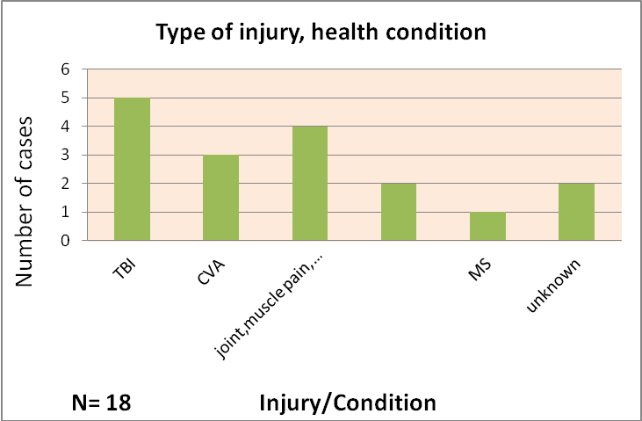
TBI = Traumatic Brain Injury CVA= Stroke MS= Multiple sclerosis

Slide 14
Berg Balance Scale
Paired t-test was made between pre- and post- outcome measure, demonstrating a statistically significant improvement
p = 0.019, (p ≤ 0.05, N= 8).
 | min | max | mean | st.dev
Pre –measures(N=18) | 27 | 56 | 50,44 | 7,94
Post-measure(N=8) | 44 | 56 | 52,87 | 4,91
TGUT (Timed `Get Up and Go` Test)
Pre- and post- measures (in seconds). Paired t-test demonstrating a statistically significant improvement
p=0.012, (p≤0.05,N=8).
 | min | max | mean | st.dev
Pre –measure(N=18) | 7 | 40 | 14,55 | 8,03
Post-measure(N=8) | 8 | 32 | 13,37 | 7,79
Both measures demonstrate a statistically significant improvement in balance and coordinated movement on completion of the TMW training programme

Slide 16
CORE-10
Paired t-test results for Total score show, overall, a close to significant statistical improvement to mood,
p=0.06 (p>0.05, N=8).
 | min | max | mean | st.dev
Pre –measure (N=18) | 0 | 32 | 14 | 9,08
Post-measure (N=8) | 3 | 27 | 17,12 | 8,27
Statistically significant differences were found in the following areas:
Core 4 “..talking to people has felt too much for me..”
p=0.009, p<0.05, N=8
Core 9 “..I have felt unhappy..”
p=0.01,p<0.05, N=8
Core 10 “..Unwanted images or memories have been distressing me..”
P=0.009,p<0.05,N=8
The results indicate specific benefits in terms of improved social confidence, elevated mood and reduced distress.

Slide 17
Wellbeing ‘star’
The ‘Wellbeing star’ is a measure of independence and participation use in a variety of health and social services settings to support people in moving into independent and self-reliant functioning. The TMW star is an initiative developed by the TMW Training service to support interdisciplinary goal setting. A score of 10 reflects the perception of full self reliance and independence on that particular construct, a score of 1 indicates that the person feels stuck and is struggling in asking for help / support.
Participation | pre-measure | 1 | 4 | 2,75 | 1,03 | p=0.04(p≤0.05, N=8)
 | post-measure | 2 | 5 | 3,37 | 0,91
On this measure, participants in the pilot study demonstrated a statistically significant improvement in their sense of participation within their life.

Slide 18
Extended TMW Long Term Conditions Study.
Sample = 214 Participants n=54 Males & 160 Females
Mean age = 61 (Range 23 – 88)
Reported Long Term Health Conditions
Traumatic brain injury n = 8
CVA / Stroke / TIA n = 11
Arthritis n = 7
Pain n = 10
Parkinson’s n = 9
MS n = 1
Fybro-myalgia / CFS n = 7
Anxiety / depression /
mood disorder n = 3
Diabetes n = 3
Other participants in the study may have a long term health condition that were unreported.
Average time from injury = 7 years (1-36)

Slide 19
The TMW Effectiveness Measure
The TMW Effectiveness measure is made up of 14 items evaluating the effectiveness of the ‘Tai Chi Movements for Wellbeing’ programme. The participants have to answer on a scale of 1 (not good/poor) to 10 (very good/no problem) questions relate to their balance, energy, confidence, worry, co-ordination, participation, emotional stability, fatigue, flexibility, problems sleeping/waking early, breathing, pain, mobility and focus and concentration.
RESULTS
TMW Effectiveness Measure
Participation | 6.20 (2.462) | 7.15 (2.231) | -3.567 | .002
Emotional Stability | 6.37 (2.362) | 7.11 (1.729) | -2.800 | .012
Fatigue | 4.53 (2.294) | 5.26 (2.746) | -2.111 | .049
Flexibility | 5.60 (1.903) | 6.80 (2.067) | -2.897 | .009
Sleep | 6.50 (2.565) | 7.20 (2.587) | -2.268 | .035
Table 1. Paired samples t-test results with significant pre and post programme score differences in bold. *p<.05
The results demonstrate significant reported improvements in energy, flexibility, sleep, emotional stability and overall participation in their life.

Slide 20
Tai Chi Focus Group – Women with Breast cancer
“…We have all needed conventional medicine to some degree…
but I was looking for something away from illness and into health.
It makes other treatments better including taking all my medicines!
It’s a whole philosophy of nurturing ourselves…learning to love yourself...”
Helps at times of anxiety and stress”
“Improved posture”
“Eased trapped nerve pain”
“Non-strenuous activity that keeps me active”
“A sense of being more centered or grounded in everyday life”
“Very helpful with movement, confidence, breathing, companionship, calmness and coordination.”
“[Tai chi has] taken the pain away completely from knees. I couldn’t really drive a car before doing Tai chi.
Walking was difficult and climbing stairs very difficult. I can [do] both with relative ease now.”

Slide 21
Service User’s Experience of TMW
The following themes were identified from the TWM LTC Study post-course feedback:
Relaxation / calming and a sense of peace
Helps prior to bedtime and with sleep
It was supportive and helpful meeting others
A good introduction to starting exercise again
Helpful with balance and flexibility / suppleness / less ‘tight’
Understanding my limits and what parts of my body can actually do
Helpful with my breathing
Being ‘mindful’ and ‘in the moment’

Slide 22
“…I….use the Tai Chi to calm myself down and its, whether it is making a gap in your anger or taking your mind away from it all. You need to concentrate to do Tai Chi …”
…it just seems to be focused more on the way you stand and your body, your posture and your body when you do the Tai Chi …”
“…It did help with the balance problems…….after I’d done the Tai Chi, when I’d finished the course, before I’d finished the course, my balance is a lot better …”
“…I found it was very, helped me to relax, it was very calming, and the first thing I started doing, because as I say I got a lot of stiffness in my right hand or my right hand side since my stroke and I find that would ease that…”
“…What I found with the Tai Chi was that it gave me…something to use to calm down all the panic…..I use the Tai Chi as a break and say ‘OK I’m going to take 20 minutes out go through the sequence, calm myself down…’

Slide 23
Summary and Conclusions
TMW present a structured, systematic and evidence based approach to the application of ‘embodied mindfulness’ to Long Term Conditions
The evidence from repeated studies demonstrate both statistical and clinical improvements in terms of movement, balance, stability, fatigue, mood and overall ‘participation’
Service users own self-reports and narratives indicate that this is perceived as a helpful, supportive and effective intervention
The study demonstrates effectiveness across a wide age range with individuals presenting with very different long term health conditions
Therefore:
TMW offers an evidence based, cost effective, clinical and psychologically significant contribution to Long Term Condition Management (physical and mental health) , valued by the service users.

Slide 24
Finally
“…Well I think its certainly three months since I’ve finished the eight week course and, yeah, it does change you, change you for the better. Yes its good…”

Slide 25
At our conference he will be talking about the psychobiosocial impact of dementia, the neuropsychology and neurobiology of dementia and the manner in which Tai Chi Movement for Wellbeing can provide support across different functional systems (physical, physiological, cognitive, sensory, emotional and behavioural).
He will present research evidence for the efficacy of the approach which will link with Richard Farmer's presentation and workshop.

Slide 26
The effects of a Multimodal Intervention on Outcomes of Persons With Early-Stage Dementia (Burgener, Yang, Gilbert, Yant, 2008)
Non-pharmacological interventions initiated early in dementias have the potential to improve outcomes, including cognition and functional ability.
The intervention consisted of Tai Chi exercises, CBT and support group participation

Slide 27
Results
Mini Mental State Examination: significant difference for treatment group, the control group subjects the scores declined. No significant differences were found at baseline
Balance measures: treatment group scores increased following the first 20 week of intervention and control group scores declined
Self Esteem Scale: between group differences were evident, treatment group scores increased slightly and control group scores declined
Depression: non-significant stabilisation effect was found, treatment group subjects increased by 0.4 and control group increased by 0.9 on the Geriatric Depression Scale

Slide 28
Reducing Disability in Alzheimer’s disease (RDAD) An evidence-Based Exercise and Behaviour Management Program for Dementia Care (Logsdon, Teri, 2010)
The exercise component of the RDAD included an individualised plan of endurance activity(walking), strength training, balance and flexibility exercises for 30 minutes of practising most days of the week.
The behaviour management component taught caregivers strategies to reduce behavioural and mood disturbances

Slide 29
Results
RDAD patients exercised significantly more, had significantly fewer restricted activity days and improved significantly more on physical functioning and depression compared to the control group
24 month follow up highlighted that changes in physical activity were maintained and additional improvements in mobility occurred in subjects receiving RDAD
With patients entering the study with higher levels of depression, significant improvements in depression were maintained at 24 months

Slide 30
Effects of a non-aerobic movement based activity on cognition in people with Alzheimer’s type dementia (Yaguez, Shaw, Morris, Matthews, 2011)
The exercise group (N=15) attended a 6 week movement training group
Cognitive functions were assessed pre and post training
Results
significant improvements were found in the exercise group for sustained attention, visual memory and a trend in working memory
in addition, the control group deteriorated significantly in attention

Slide 31
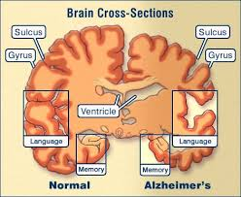
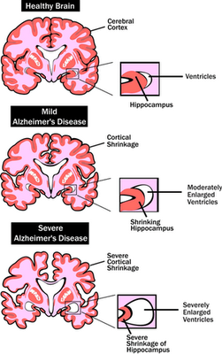
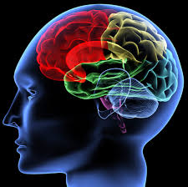
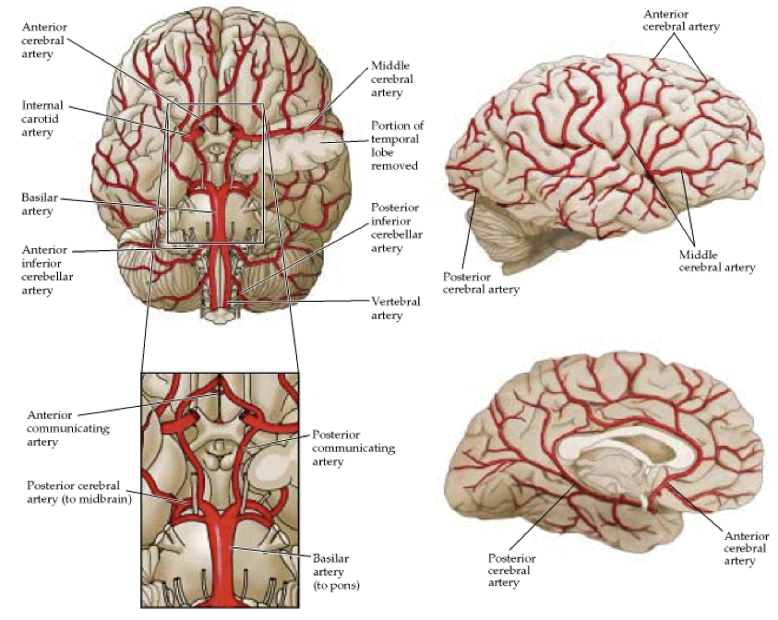
The neuropsychlogy of dementia and cerebral blood flow

Slide 32
The SEA (Social Cognition and Emotional Assessment): A Clinical Neuropsychological Tool for Early Diagnosis of Frontal Variant of Fronto-temporal Lobar Degeneration(fvFTD) (Levy, Dubois, 2011)
Background:
Fronto-temporal lobar degeneration is the second most common neurodegenerative cause of dementia in patients below 65 years
The precise clinical evaluation of patients presenting diseases affecting the ventral or medial prefrontal cortex is unsatisfactory
The SEA is composed of five subtests: identification of facial emotions, reversal/extinction task, behavioural control, theory of mind and apathy

Slide 33
Results:
Maximum score of SEA is 55 and a score obtained below 39.4 is pathological even in cases where assessment of cognitive performance is normal
The SEA showed maximum sensitivity to discriminate fvFTD patients from normal control subjects and maximum specificity to discriminate fvFTD patients from Alzheimer's Disease and amnesic Mild Cognitive Impairment patients

Slide 34
Physical activity for preventing cognitive decline in people with mild cognitive impairment (MCI) (Barber, Clegg, Young, 2012)
MCI- widely regarded as a transitional syndrome between normal cognitive aging and clinical dementia
Mechanisms of neuro-protection through physical activity:
Exercise has been shown to regulate several neurothropic and vascular growth factors and the changes are thought to increase neurogenesis, angiogenesis, synaptic plasticity and dendritic spine density in the hippocampus.
Exercise has been shown to enhance the expression of genes that regulate the production of free -radical scavenging enzymes, which may reduce free radical damage to neurons and neurodegenerative diseases
Improved insulin resistance may directly increase synaptic plasticity and energy mechanisms

Slide 35
Evidence from existing randomised controlled trials:
high intensity aerobic exercise, 29 participants with MCI. The exercise group improved in aspects of executive function(P=0.04) (Baker et al., 2011)
moderate intensity exercise training/physical activity interventions for MCI Memory improvement in men (P=0.04), attention improvements in women (P=0.04). (Van Uffelen et al., 2008)
Challenges of developing physical activity interventions for people with MCI:
reluctance to start exercise, fear of injury, pain, report no social support to exercise
cognitive obstacles: remembering routine, slow acquisition of skill

Slide 36
References
1.The effects on cognitive functions of a movement-based intervention in patients with Alzheirmer’s type dementia: a pilot study.
Lidia Yaguez, Kendra N. Shaw, Robin Morris, David Matthews
International Journal of Geriatric Psychiatry 2011
2. Is there a role for physical activity in preventing cognitive decline in people with mild cognitive impairment?
Sally E.Barber, Andrew P. Clegg, John B. Young
Age and Ageing (2012)
3. An evidence-Based Exercise and Behaviour Management Program for Dementia Care
Rebecca G. Logsdon, Linda Teri
Journal of the American Society of Ageing, 2010
4.The effects of a Multimodal Intervention on Outcomes of Persons With Early-Stage Dementia
Sandy C. Burgener, PhD, APRN-BC, FAAn, Yang Yang, PhD, Ruth Gilbert, MA, and Sara Marsh-Yant, MSW
American Journal of Alzheimer’s Disease & Other Dementias 2008
5. The SEA (Social Cognition and Emotional Assessment): A Clinical Neuropsychological Tool for Early Diagnosis of Frontal Variant of Frontotemporal Lobar Degeneration
Richard Levy, Bruno Dubois, Aurelie Funkiewiez, Maxime Bertoux, Leonardo Cruz de Souza
Neuropsychology, 2012

